Slide 1
Predicting single-family home prices using economic and social indicators
Ledia Dobi Conie o’Malley ITEC 621 SpRING 2025

Slide 2
Business question – Analytics question -

Slide 3
Description of the dataset
Zillow
Federal Reserve Economic Database
NYPD Crime Stats
Dummy Variables
median home sale prices,
federal interest rate
15-year mortgage rates,
30-year mortgage rates
NY median household income
national median household income
unemployment rates
new construction sales
mean home values
rental cost index
misdemeanor offenses
major felonies
non-seven major felonies
2008 Financial Crisis
COVID-19 Pandemic
Notes:
Non-seven major felonies: felony possession of stolen property, forgery/theft fraud/identity theft, arson, felony sex crimes, felony dangerous weapons, felony dangers drugs, felony criminal mischief & related offenses, other felonies

Slide 4
Complications/challenges
Addressing missing values
Standardizing all data to a monthly frequency, using averaging for variables reported at less frequent intervals
Ensuring data consistency and accuracy (dates, dimensions)

Slide 5
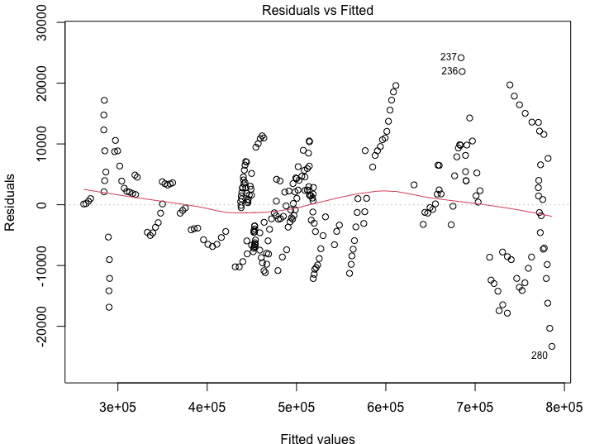
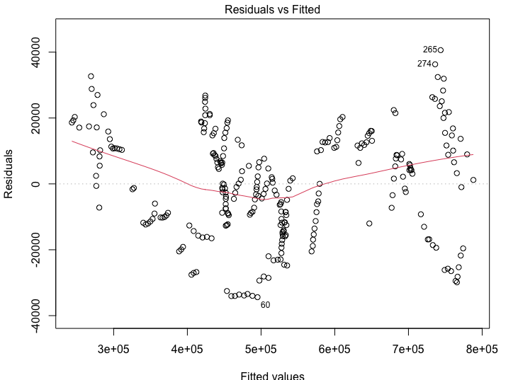
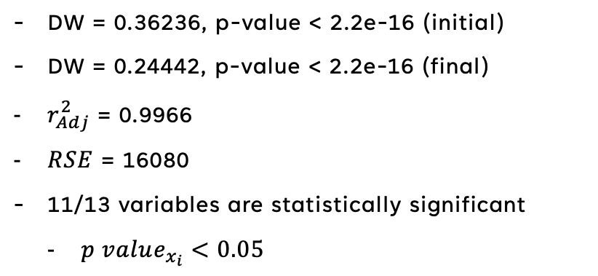
Explanation of model selection process, alternatives, model specifications
OLS
Fit an OLS model with all predictors and reduced based on p-value
Found heteroskedasticity and nonnormality
Typical for time series data
Created lagged date-related variables
Serial correlation persisted
Fig. 1 – Initial OLS Model Residual vs. Fitted Plot
Results
DW = 0.36236, p-value < 2.2e-16 (initial)
DW = 0.24442, p-value < 2.2e-16 (final)
$r_{Adj}^{2}$ = 0.9966
$RSE$ = 16080
11/13 variables are statistically significant
$p value_{x_{i}}<0.05$
Fig. 2 – Final OLS Model Residual vs. Fitted Plot

Slide 6
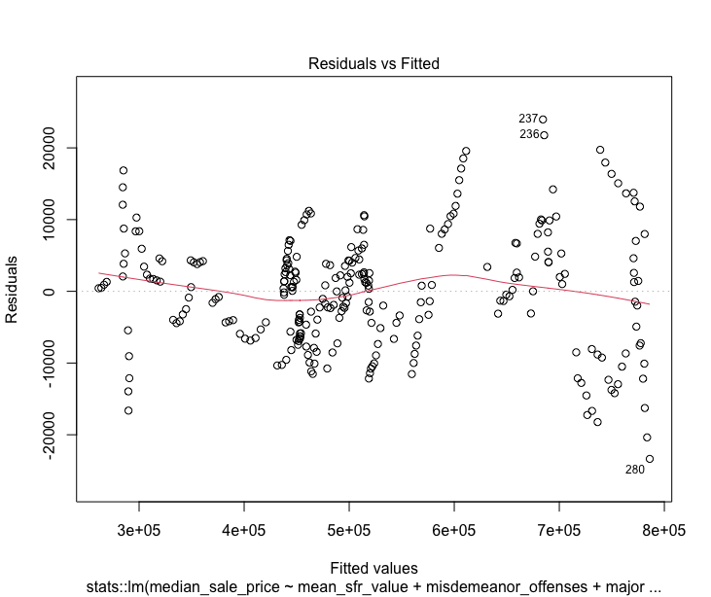
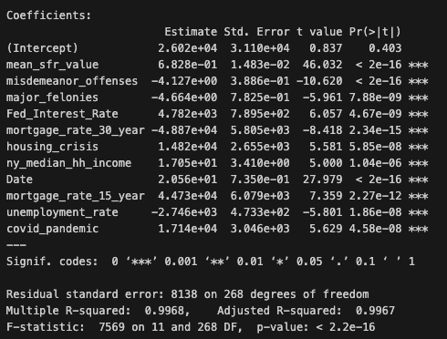
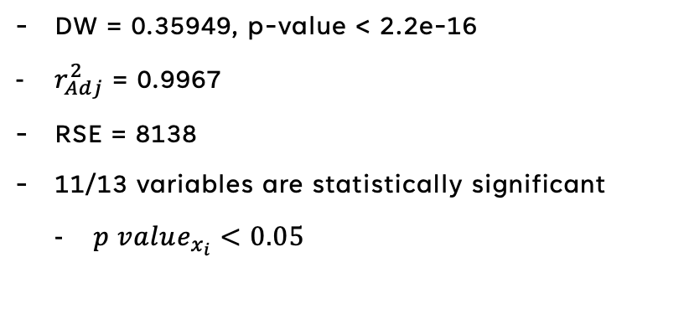
Explanation of model selection process, alternatives, model specifications
WLS
Fit a WLS model with all predictors and reduced based on stepwise regression
Found heteroskedasticity and nonnormality
Typical for time series data
Transforming and lagging date-related variables but correlation persisted
Fig. 3 – WLS Model Residual vs. Fitted Plot
Results
DW = 0.35949, p-value < 2.2e-16
$r_{Adj}^{2}$ = 0.9967
RSE = 8138
11/13 variables are statistically significant
$p value_{x_{i}}<0.05$
Fig. 4 – WLS Summary Statistics

Slide 7
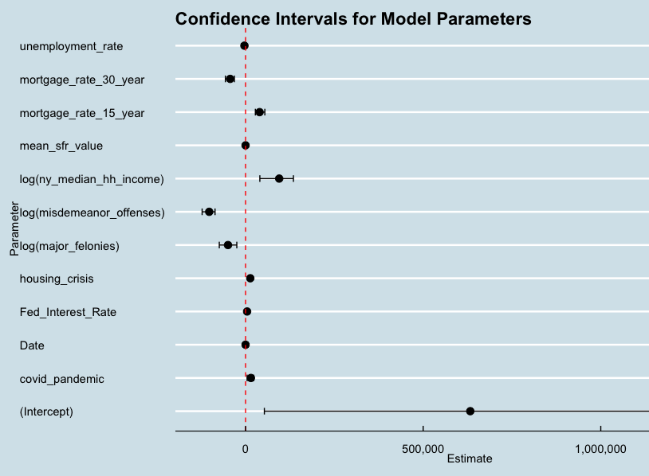
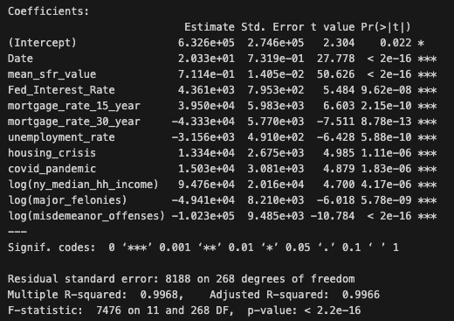
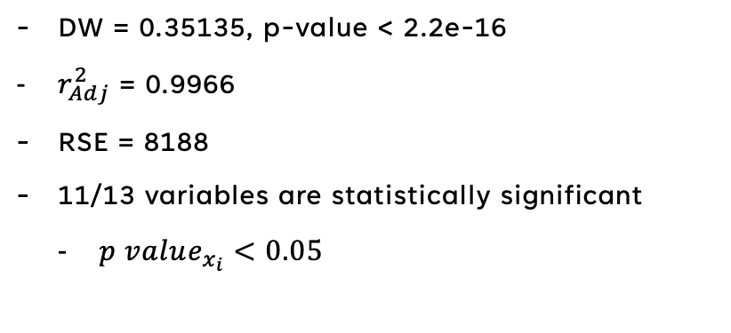
Explanation of model selection process, alternatives, model specifications
Bootstrap
Performed log transformation on yearly variables converted to monthly (crime, income)
Found heteroskedasticity and nonnormality
Typical for time series data
Transforming and lagging date-related variables but correlation persisted
Fig. 5 –Bootstrap Confidence Interval Plot
Results
DW = 0.35135, p-value < 2.2e-16
$r_{Adj}^{2}$ = 0.9966
RSE = 8188
11/13 variables are statistically significant
$p value_{x_{i}}<0.05$
Fig. 6 – Final Model Summary Statistics

Slide 8

Explanation of model selection process, alternatives, model specifications
Cross Validation
Performed 10-fold Cross Validation on final model after bootstrapping
Found heteroskedasticity and nonnormality
Typical for time series data
Transforming and lagging date-related variables but correlation persisted
Fig. 6 –Bootstrap Confidence Interval Plot
Results
DW = 0.35135, p-value < 2.2e-16
$r_{Adj}^{2}$ = 0.9966
RSE = 8188
11/13 variables are statistically significant
$p value_{x_{i}}<0.05$
Fig. 7 – Model Comparison Table

Slide 9
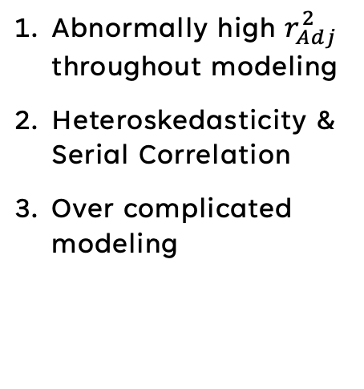
Relevant results
RESULTS
Solutions
Abnormally high $r_{Adj}^{2}$ throughout modeling
Heteroskedasticity & Serial Correlation
Over complicated modeling
Variable selection - review data selection process and try to be more creative with variables that could be explanatory (e.g., COVID Pandemic, 2008 Financial Crisis)
Variable selection – lots of data was correlated and we attempted to correct for this, but could not eliminate all the problems with heteroskedasticity & serial correlation
Variable selection – being able to cut down on variables that may not be necessary to simplify the model (even if variables are statistically significant or anecdotally significant)

Slide 10
conclusion
Practice makes perfect
Continue improving
Consistent rehearsal
Strengthen your familiarity
Refine delivery style
Pacing, tone, and emphasis
Timing and transitions
Aim for seamless, professional delivery
Practice audience
Enlist colleagues to listen & provide feedback
Seek feedback
Reflect on performance
Explore new techniques
Set personal goals
Iterate and adapt

